Slide 1

PROJECT MANAGEMENT
Lecture # 05

Slide 2
When making the project, need the knowledge of there areas is must.

Slide 3
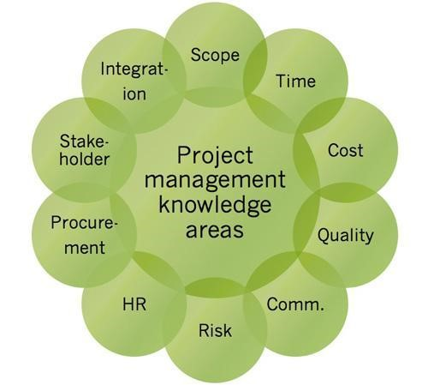

Slide 4
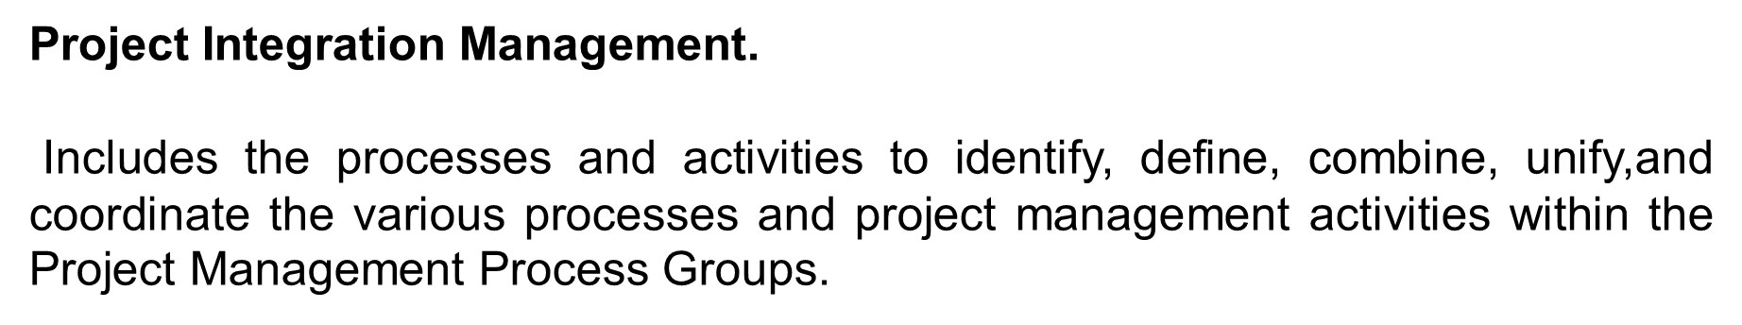
Project Scope Management.
Includes the processes required to ensure the project includes all the work required, and only the work required, to complete the project successfully.

Slide 5
Project time Management.
Includes the processes required to manage the timely completion of the project.
Project Cost Management.
Includes the processes involved in planning, estimating, budgeting, financing,funding, managing, and controlling costs so the project can be completed within the approved budget.
Project Quality Management.
Includes the processes for incorporating the organization’s quality policy
regarding planning, managing, and controlling project and product quality requirements, in order to meet
stakeholders’ expectations.
Project Resource Management.
Includes the processes to identify, acquire, and manage the resources needed for the successful completion of the project.

Slide 6
Project Communications Management. Includes the processes required to ensure timely and appropriate planning, collection, creation, distribution, storage, retrieval, management, control, monitoring, and ultimate disposition of project information.
Project Risk Management. Includes the processes of conducting risk management planning, identification,analysis, response planning, response implementation, and monitoring risk on a project.
Project Procurement Management. Includes the processes necessary to purchase or acquire products,services, or results needed from outside the project team.
Project Stakeholder Management.
Includes the processes required to identify the people, groups, or
organizations that could impact or be impacted by the project, to analyze stakeholder expectations and their impact on the project, and to develop appropriate management strategies for effectively engaging stakeholders in project decisions and execution.

Slide 7
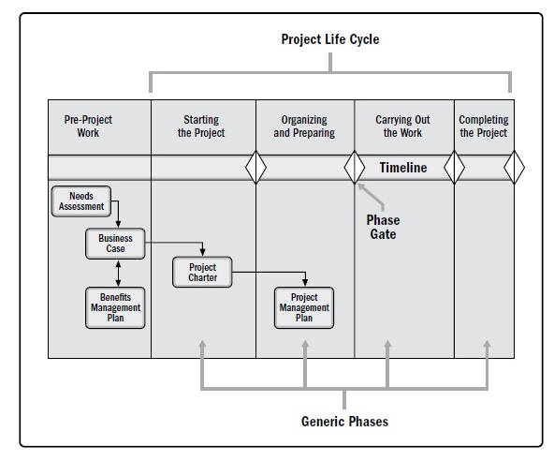

Slide 8
PROJECT BENEFITS MANAGEMENT PLAN

Slide 9
Target benefits (e.g., the expected tangible and intangible value to be gained by the implementation of the project; financial value is expressed as net present value);
Strategic alignment (e.g., how well the project benefits align to the business strategies of the organization);
Timeframe for realizing benefits (e.g., benefits by phase, short-term, long-term, and ongoing);
Benefits owner (e.g., the accountable person to monitor, record, and report realized benefits throughout the timeframe established in the plan);
Metrics (e.g., the measures to be used to show benefits realized, direct measures, and indirect measures);
Assumptions (e.g., factors expected to be in place or to be in evidence); and
Risks (e.g., risks for realization of benefits).

Slide 10
PROJECT CHARTER AND PROJECT MANAGEMENT PLAN
The project charter is defined as a document issued by the project sponsor that formally authorizes the existence of a project and provides the project manager with the authority to apply organizational resources to project activities.
The project management plan is defined as the document that describes how the project will be executed, monitored, and controlled

Slide 11
PROJECT SUCCESS MEASURES
One of the most common challenges in project management is determining whether or not a project is successful.
Traditionally, the project management metrics of time, cost, scope, and quality are the most important factors in defining the success of a project. More recently, practitioners and scholars have determined that project success should also be measured with consideration toward achievement of the project objectives.
Project stakeholders may have different ideas as to what the successful completion of a project will look like and which factors are the most important. It is critical to clearly document the project objectives and to select objectives that are measurable.
Three questions that the key stakeholders and the project manager should answer are:
What does success look like for this project?
How will success be measured?
What factors may impact success?

Slide 12
Completing the project benefits management plan;
Meeting the agreed-upon financial measures documented in the business case. These financial measures may include but are not limited to:
Net present value (NPV),
Return on investment (ROI),
Internal rate of return (IRR),
Payback period (PBP), and
Benefit-cost ratio (BCR).

Slide 13
Meeting business case nonfinancial objectives;
Completing movement of an organization from its current state to the desired future state;
Fulfilling contract terms and conditions;
Meeting organizational strategy, goals, and objectives;
Achieving stakeholder satisfaction;
Acceptable customer/end-user adoption;
Integration of deliverables into the organization’s operating environment;
Achieving agreed-upon quality of delivery;
Meeting governance criteria; and
Achieving other agreed-upon success measures or criteria (e.g., process throughput).

Slide 14
THE ENVIRONMENT IN WHICH PROJECTS OPERATE

Slide 15
Projects exist and operate in environments that may have an influence on them. These influences can have a favorable or unfavorable impact on the project. Two major categories of influences are enterprise environmental factors (EEFs) and organizational process assets (OPAs).
EEFs originate from the environment outside of the project and often outside of the enterprise. EEFs may have an
impact at the organizational, portfolio, program, or project level.
OPAs are internal to the organization. These may arise from the organization itself, a portfolio, a program, another
project, or a combination of these.

Slide 16
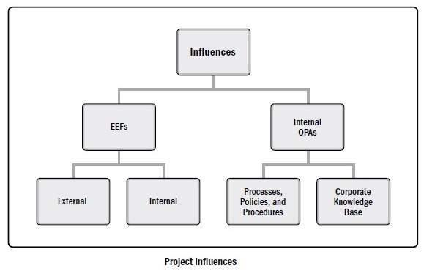

Slide 17
EEFS INTERNAL TO THE ORGANIZATION
The following EEFs are internal to the organization:
Organizational culture, structure, and governance. Examples include vision, mission, values, beliefs, cultural norms, leadership style, hierarchy and authority relationships, organizational style, ethics, and code of conduct.
Geographic distribution of facilities and resources. Examples include factory locations, virtual teams, shared systems, and cloud computing.
Infrastructure. Examples include existing facilities, equipment, organizational telecommunications channels, information technology hardware, availability, and capacity.
Information technology software. Examples include scheduling software tools, configuration management systems, web interfaces to other online automated systems, and work authorization systems.
Resource availability. Examples include contracting and purchasing constraints, approved providers and subcontractors, and collaboration agreements.
Employee capability. Examples include existing human resources expertise, skills, competencies, and specialized knowledge.

Slide 18
EEFS EXTERNAL TO THE ORGANIZATION
The following EEFs are external to the organization.
Marketplace conditions. Examples include competitors, market share brand recognition, and trademarks.
Social and cultural influences and issues. Examples include political climate, codes of conduct, ethics ,and perceptions.
Legal restrictions. Examples include country
or local laws and regulations related to security, data protection, business conduct, employment, and procurement.
Commercial databases. Examples include benchmarking results, standardized cost estimating data, industry risk study information, and risk databases.
Academic research. Examples include industry studies, publications, and benchmarking results.
Government or industry standards. Examples include regulatory agency regulations and standards related to products, production, environment, quality, and workmanship.
Financial considerations. Examples include currency exchange rates, interest rates, inflation rates, tariffs, and geographic location.
Physical environmental elements. Examples include working conditions, weather, and constraints.

Slide 19
ORGANIZATIONAL PROCESS ASSETS
Organizational process assets (OPAs) are the plans, processes, policies, procedures, and knowledge bases specific to and used by the performing organization. These assets influence the management of the project.
OPAs include any practice, or knowledge from any or all of the performing organizations involved in the project that can be used to execute or govern the project. The OPAs also include the organization’s lessons learned from previous projects and historical information.

Slide 20
MANAGEMENT ELEMENTS
The key functions or principles of management include but are not limited to:
Division of work using specialized skills and availability to perform work;
Authority given to perform work;
Responsibility to perform work appropriately assigned based on such attributes as skill and experience;
Discipline of action (e.g., respect for authority, people, and rules);
Unity of command (e.g., only one person gives orders for any action or activity to an individual);
Unity of direction (e.g., one plan and one head for a group of activities with the same objective);
General goals of the organization take precedence over individual goals;
Paid fairly for work performed;

Slide 21
Optimal use of resources;
Right materials to the right person for the right job at the right time;
Fair and equal treatment of people in the workplace;
Clear security of work positions;
Safety of people in the workplace;
Open contribution to planning and execution by each person; and
Optimal morale

Slide 22
Factors to consider in selecting an organizational structure include
but are not limited to:
Degree of alignment with organizational objectives,
Specialization capabilities,
Span of control, efficiency, and effectiveness,
Clear path for escalation of decisions,
Clear line and scope of authority,
Delegation capabilities,
Accountability assignment,
Responsibility assignment,
Adaptability of design,
Simplicity of design,
Efficiency of performance,
Cost considerations,
Physical locations (e.g., colocated, regional, and virtual), u Clear communication (e.g., policies, status of work, and organization’s vision).

Slide 23
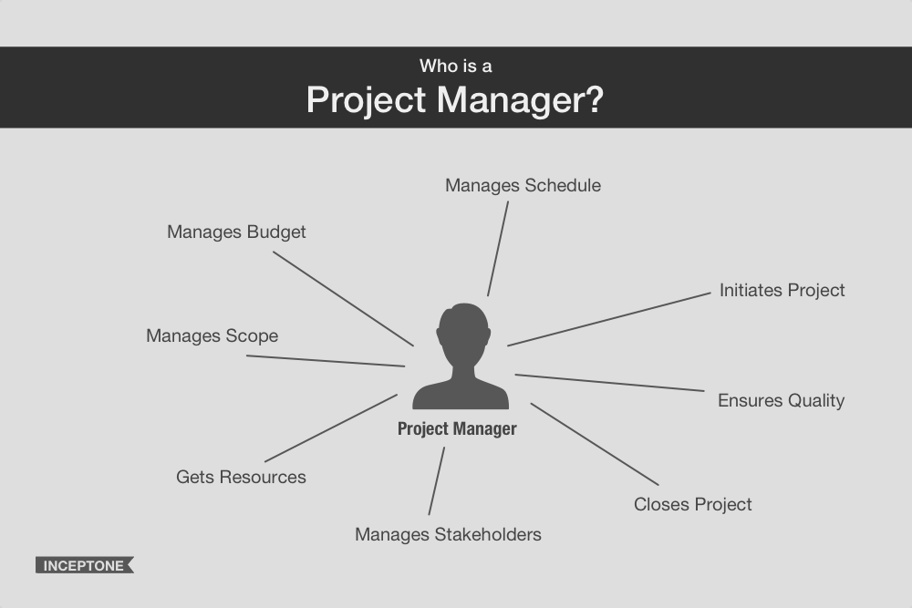
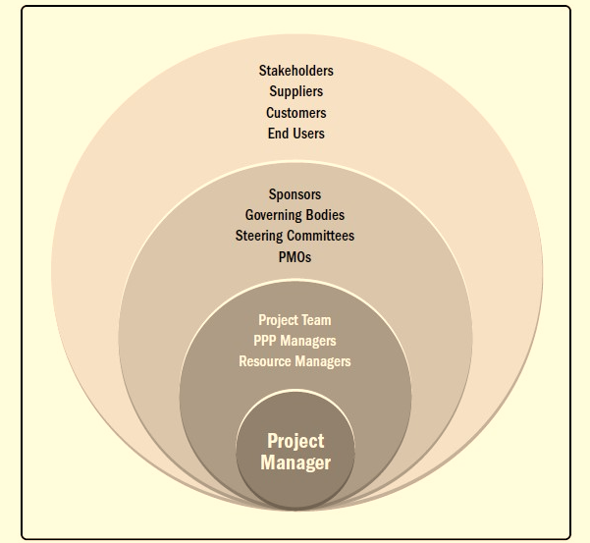
THE ROLE OF THE PROJECT MANAGER
A Public Private Partnership

Slide 24
QUALITIES OF GOOD PROJECT PROJECT MANAGER
The project manager leads the project team to meet the project’s objectives and stakeholders’ expectations. The project manager works to balance the competing constraints on the project with the resources available.
The project manager also performs communication roles between the project sponsor, team members, and other stakeholders. This includes providing direction and presenting the vision of success for the project. The project manager uses soft skills (e.g., interpersonal skills and the ability to manage people) to balance the conflicting and competing goals of the project stakeholders in order to achieve consensus. In this context, consensus means that the relevant stakeholders support the project decisions and actions even when there is not 100% agreement.
Research shows that successful project managers consistently and effectively use certain essential skills. Research reveals that the top 2% of project managers as designated by their bosses and team members distinguish themselves by demonstrating superior relationship and communication skills while displaying a positive attitude

Slide 25
PROJECT MANAGER COMPETENCES
Technical : The knowledge, skills, and behaviors related to specific domains of project, program, and portfolio management.
The technical aspects of performing one’s role.
Leadership. The knowledge, skills, and behaviors needed to guide, motivate, and direct a team, to help an organization achieve its business goals.
Strategic and business management. The knowledge of and expertise in the industry and organization that enhanced performance and better delivers business outcomes.

Slide 26
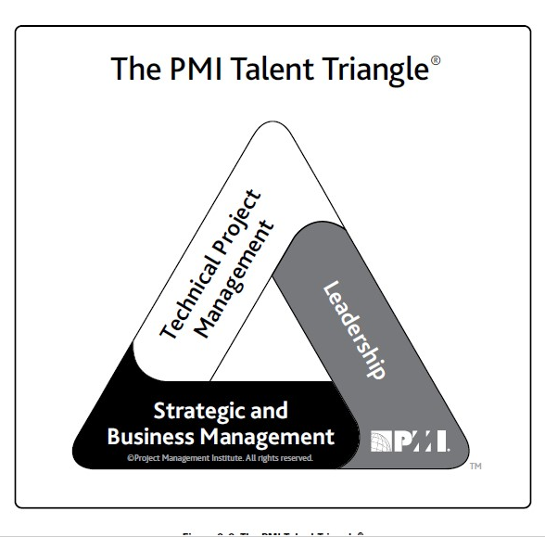

Slide 27
The project manager should be knowledgeable enough to explain to others the following aspects of the organization:
Strategy;
Mission;
Goals and objectives;
Products and services;
Operations (e.g., location, type, technology);
The market and the market condition, such as customers, state of the market (i.e., growing or shrinking), and
time-to-market factors, etc.; and
Competition (e.g., what, who, position in the market place).

Slide 28
LEADERSHIP SKILLS IN PROJECT MANAGER
Leadership skills involve the ability to guide, motivate, and direct a team. These skills may include demonstrating essential capabilities such as negotiation, resilience, communication, problem solving, critical thinking, and interpersonal skills. Projects are becoming increasingly more complicated with more and more businesses executing their strategy through projects. Project management is more than just working with numbers, templates, charts, graphs, and computing
systems.

Slide 29
Being a visionary (e.g., help to describe the products, goals, and objectives of the project; able to dream and translate those dreams for others);
Being optimistic and positive;
Being collaborative;
Managing relationships and conflict by:
Building trust;
Satisfying concerns;
Seeking consensus;
Balancing competing and opposing goals;
Applying persuasion, negotiation, compromise, and conflict resolution skills;
Developing and nurturing personal and professional networks;
Taking a long-term view that relationships are just as important as the project;

Slide 30
Continuously prioritizing work by reviewing and adjusting as necessary;
Finding and using a prioritization method that works for them and the project;
Differentiating high-level strategic priorities, especially those related to critical success factors for the project;
Maintaining vigilance on primary project constraints;
Remaining flexible on tactical priorities; and
Being able to sift through massive amounts of information to obtain the most important information.
Having a holistic and systemic view of the project, taking into account internal and external factors equally;
Being able to apply critical thinking (e.g., application of analytical methods to reach decisions) and identify him
or herself as a change agent.
Being able to build effective teams, be service-oriented, and have fun and share humor effectively with team embers.

Slide 31
POLITICS, POWER, AND GETTING THINGS DONE
Leadership and management are ultimately about being able to get things done. The skills and qualities noted help the project manager to achieve the project goals and objectives. At the root of many of these skills and qualities is the ability to deal with politics. Politics involves influence, negotiation, autonomy, and power.
Politics and its associated elements are not “good” or “bad,” “positive” or “negative” alone. The better the project
manager understands how the organization works, the more likely he or she will be successful. The project manager
observes and collects data about the project and organizational landscapes. The data then needs to be reviewed in the context of the project, the people involved, the organization, and the environment as a whole.

Slide 32
LEADERSHIP STYLES SHOULD BE EMBADED IN PROJECT MANAGER
Project managers may lead their teams in many ways. The style a project manager selects may be a personal preference, or the result of the combination of multiple factors associated with the project. The style a project manager uses may change over time based on the factors in play. Major factors to consider include but are not limited to:
Leader characteristics (e.g., attitudes, moods, needs, values, ethics);
Team member characteristics (e.g., attitudes, moods, needs, values, ethics);
Organizational characteristics (e.g., its purpose, structure, and type of work performed); and
Environmental characteristics (e.g., social situation, economic state, and political elements).

Slide 33
LEADERSHIP STYLES, SELECT SHOULD BE IN PROJECT MANAGER
Transactional (e.g., focus on goals, feedback, and accomplishment to determine rewards; management
by exception);
Servant leader (e.g., demonstrates commitment to serve and put other people first; focuses on other people’s growth, learning, development, autonomy, and well-being; concentrates on relationships, community and
collaboration; leadership is secondary and emerges after service);
Transformational (e.g., empowering followers through idealized attributes and behaviors, inspirational motivation,
encouragement for innovation and creativity, and individual consideration);
Charismatic (e.g., able to inspire; is high-energy, enthusiastic, self-confident; holds strong convictions); and
Interactional (e.g., a combination of transactional, transformational, and charismatic).

Slide 34
PERFORMING INTEGRATION
The role of the project manager is twofold when performing integration on the project:
Project managers play a key role in working with the project sponsor to understand the strategic objectives and
ensure the alignment of the project objectives and results with those of the portfolio, program, and business
areas. In this way, project managers contribute to the integration and execution of the strategy.
Project managers are responsible for guiding the team to work together to focus on what is really essential at the project level. This is achieved through the integration of processes, knowledge, and people.
Integration is a critical skill for project managers. Integration is covered more in depth in the Project Integration

